Slide 1


Development of Power Monitoring and Control System for Smart Grid
Final Defense Presentation of

Slide 2
Engr .Dr. Rehan Liaqat
Mubashir Bashir
M Aamir Shehzad
Muhammad Zahid
Muhammad Umer Farooq
12766
12727
12715
12708
-2-

Slide 3
Contents:
Hardware Components
FYP Overview
Objectives
Mapping of Sustainable Development Goals (SDGs) with FYP
Thank You
Block Diagram
-3-

Slide 4
FYP Overview:
Electric power systems are critical to modern society, providing the energy required for everything from lighting and heating to manufacturing and transportation.
A smart grid is an electricity network that uses digital and other advanced technologies to monitor and manage the transport of electricity from all generation sources to meet the varying electricity demands of end users.
The purpose of this project is to develop a system for monitoring and analyzing the power quality of an electrical grid.
The objectives of the project are to identify issues related to power quality such as harmonic distortion, power factor imbalances, and voltage fluctuations, and to implement corrective actions such as power factor correction or voltage regulation to improve power quality and reduce energy waste.
The project will improve the reliability and efficiency of the electrical grid, leading to cost savings, reduced downtime, and increased customer satisfaction.

Slide 5
Objectives:
The followings are the objectives of this project.
To monitor and analyze the power quality parameters of an electrical grid including voltage, power factor, and voltage stabilizer.
To identify issues related to power quality such as voltage stabilizer, low power factor, and voltage fluctuations.
To improve the reliability and efficiency of the electrical grid using power quality improvement devices.

Slide 6
Literature Review
Power quality parameters such as voltage, power factor, and harmonics are crucial for ensuring the efficient operation of electrical grids. Monitoring and analyzing these parameters are essential for identifying issues and implementing effective solutions [1]. Recent advancements in power quality monitoring include the utilization of high-resolution power quality analyzers, smart grid technologies, and sophisticated software tools. These tools enable real-time data collection and analysis, allowing for the detection of transient events and long-term trends [2].

Slide 7
Literature Review
Various power quality improvement devices, including harmonic filters, power factor correction devices, and voltage regulators, play a vital role in enhancing grid reliability and efficiency [3].
Monitoring and analyzing power quality parameters, including voltage, power factor, and harmonics, is vital for maintaining the efficiency and reliability of electrical grids. Advanced monitoring technologies and analytical methods facilitate the detection and mitigation of power quality issues [4].

Slide 8
Block Diagram:
Main controller
AC Voltage Stabilizer
Voltage sensor
Arduino
Current sensor
Power factor correction
LCD display
Cloud Monitoring
AC 220V
Load

Slide 9

Hardware Components:
LCD:
We use 20x2 LCD.
A 20x2 LCD means it can display 20 characters per line and there are 2 such lines.
Black text on green background.
This LCD has two registers, namely, Command and Data.
This is standard HD44780 controller LCD.

Slide 10
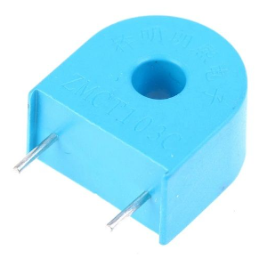
Hardware Components:
Current Sensor
Used to measure electric current.
Measurement of current ranges from picoamps to tens of thousands of amperes.

Slide 11
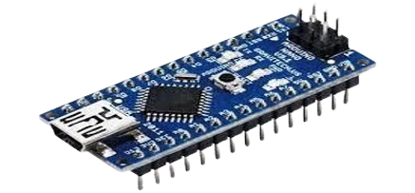
Hardware Components:
Arduino Nano
Microcontroller
Open Source: Hardware and software are freely available.
IO Pins: 14 digital, 6 analog input/output pins.
Power Supply: USB or external power (5V).
Programming: Arduino IDE, based on Wiring language.
Community Support: Large and active user community.

Slide 12
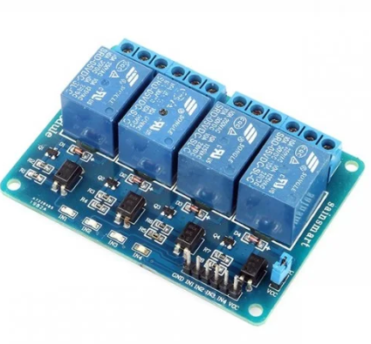
Hardware Components:
4 -Channel Relay Module:
Interface via digital I/O pins
LED working status indicator for each relay.
High quality relay COM, NO(Normally Open) and NC(Normally Close) relay pins for each relay.

Slide 13
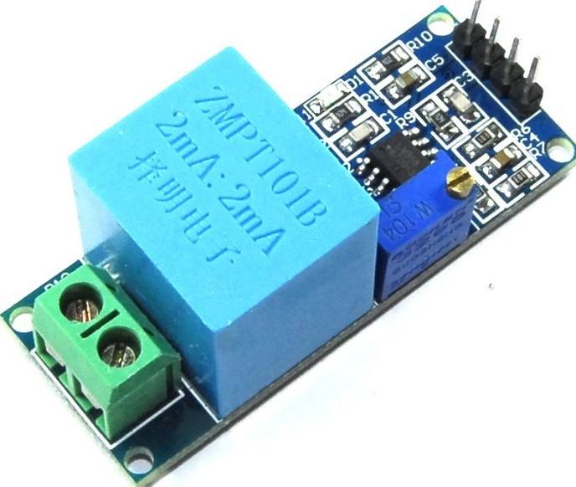
Hardware Components:
Voltage Sensor:
Voltage up to 250 volts can be measured
Operating temperature: 40°C + 70°C 5.
Supply voltage 5 volts to 30 volts
Very efficient and accuracy
Good consistency, for voltage and power measurement.

Slide 14
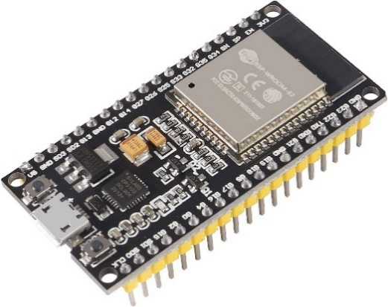
Hardware Components:
ESP32
ESP32 is a chip that provides Wi-Fi and (in some models) Bluetooth connectivity for embedded devices – in other words, for IoT devices.
While ESP32 is technically just the chip, the modules and development boards that contain this chip are often also referred to as “ESP32” by the manufacturer.

Slide 15
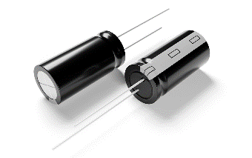
Hardware Components:
Capacitors
Capacitors contained in most power factor correction equipment draw current that leads the voltage.
Producing a leading power factor.
If capacitors are connected to a circuit that operates at a nominally lagging power factor.

Slide 16
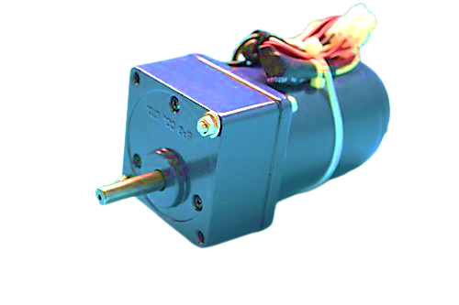
Hardware Components:
Motor Load
When AC motors handle variable loads, their power factor changes, typically being lower at light loads and higher at full loads.
Variable Frequency Drives (VFDs) help maintain a better power factor by adjusting the motor's speed and torque.
This improves energy efficiency and reduces operational costs in applications with fluctuating load demands.
Efficient power factor management is crucial for optimizing motor performance and longevity.

Slide 17
Mapping to SDGs
There are 17 sustainable development goals given by United Nations Development Programe (UNDP).
Goal No. | Statement | Description | Justification
7 | Affordable and Clean Energy | Ensure access to affordable, reliable, sustainable, and modern energy for all. | System can help identify areas where energy efficiency can be improved, reduce energy losses, and optimize the use of renewable energy sources, ultimately leading to more affordable and clean energy for all.
9 | Industry, Innovation and Infrastructure | Build resilient infrastructure, promote inclusive and sustainable industrialization, and foster innovation. | It can help identify areas where infrastructure improvements are needed, optimize the use of existing infrastructure, and support the development of innovative solutions that improve the resilience and sustainability of infrastructure.
11 | Sustainable Cities and Communities | Make cities and human settlements inclusive, safe, resilient and sustainable. | The system can help improve the efficiency and reliability of electricity supply to urban areas.
13 | Climate Action | Take urgent action to combat climate change and its impacts. | System can help optimize the use of renewable energy sources, reduce greenhouse gas emissions, and support the development of more sustainable energy systems, ultimately contributing to climate change mitigation and adaptation efforts.
17 | Partnerships for the Goals - | Strengthen the means of implementation and revitalize the global partnership for sustainable development. | By promoting collaboration and partnership between different stakeholders, such as energy providers, regulators, and consumers, the system can help identify and address common challenges related to energy access, sustainability, and resilience, ultimately contributing to the achievement of the SDGs through collective action.
17

Slide 18
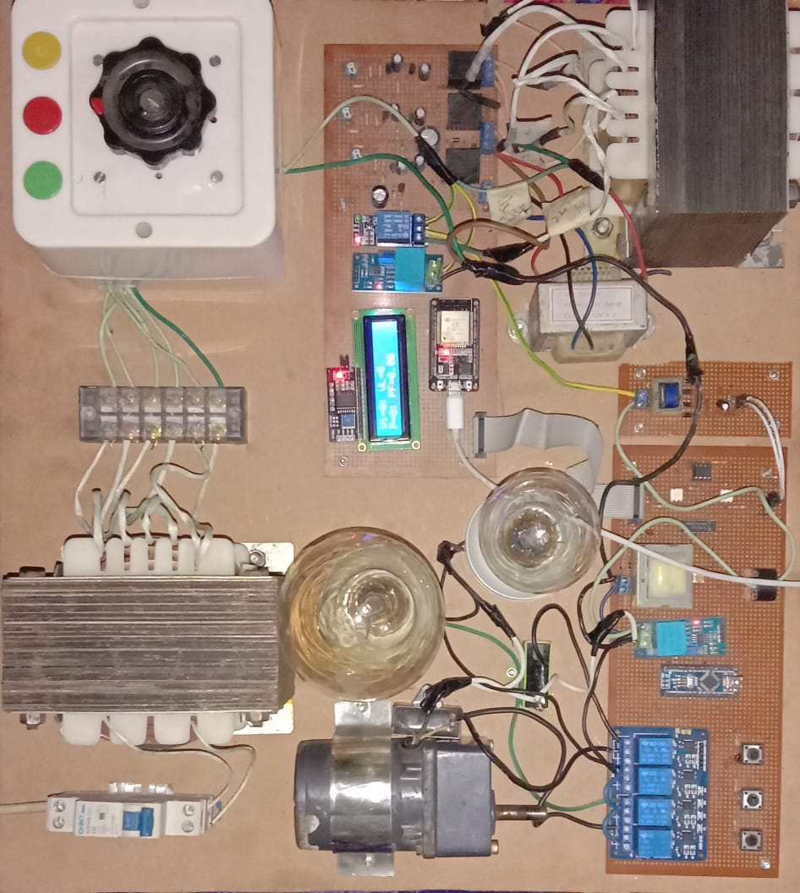
Final View

Slide 19
Thank You
Questions
?
-19-

